Slide 1
Leading Participant-Centered Research:
An Argument for Taking a More Strategic Role as User Experience Architects
MSU WIDE Research
Cait Ryan, MA - @CaitRyan // Liza Potts, PhD. - @LizaPotts
Notes:
Hi, my name is Cait Ryan. I’m a design researcher at TechSmith Corporation, a software company best known for creating tools such as Snagit, Camtasia, and Morae.
I’m also a recent graduate from MSU’s Masters program in Digital Rhetoric and Professional Writing.

Slide 2
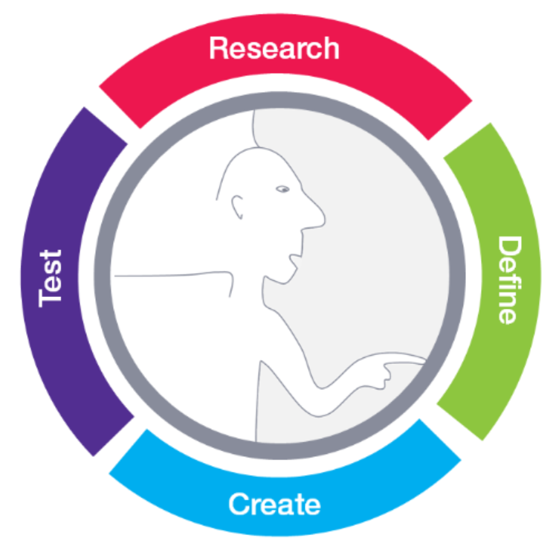
Why Hasn’t Participant-Centered Research Arrived?
From Patrick D. Esser http://www.meetpatrick.de/
@CaitRyan // @LizaPotts
Notes:
The talk that we’re giving today began to form when Liza and I were trying to put together a new undergraduate course focusing on Participant-Centered Research for MSU’s program in experience architecture.
We started by doing a survey of the current state of participant-centered research,
As part of this search, we kept coming back to the realization that this type of research hasn’t really arrived in industry.
It hasn’t become an integral part of the product and service development process at most companies, even companies that see the importance of participant-centered research and have invested money in practicing it.
And we started to wonder why is that, why hasn’t it arrived.

Slide 3
But First, What Is Participant-Centered Research?
“Systematic Inquiry”
Erika Hall
@CaitRyan // @LizaPotts
Notes:
I’ll get to the answer, but before I do,
I first want to define what we mean when we say participant centered research. Industry expert Erika Hall defines research in Just Enough Research as “systematic inquiry.” Or, in other words: “you want to know more about a particular topic, so you go through a process to increase your knowledge. The type of process depends on who you are and what you need to know” [12].
In the case of participant-centered research, you need to know about people’s actual behavior in a particular activity or activities in order to create useful and usable products and services, so you go through a process that involves engaging directly with people who participate the activity you’re trying to improve.

Slide 4
There’s No Better Time To Practice UX Research
@CaitRyan // @LizaPotts
Notes:
So back to the question of why we weren’t seeing companies successfully integrated this kind of research into their process.
We realized that it wasn’t because of a lack of interest or investment.
We found numerous well-known practitioners including Steve Portigal, James Spool, and Tomer Sharon asserting that there has been no better time than the present to be a user research practitioner.
A quick search of the job market proves this out. A quick search on the job site Indeed with the term “user research” found over 2,000 job postings requiring these skills, and that was just one job site on one random day.

Slide 5
Resources Are Abundant
@CaitRyan // @LizaPotts
Notes:
It also wasn’t because of a lack of available knowledge and resources.
We found an abundance to choose from.
For example, Rosenfeld has created an entire series full of books to help people learn user research practices.
A book apart has also published numerous books for industry practitioners, and 100s of articles to help people learn to how to incorporate these research practices into the process of creating products and services.

Slide 6
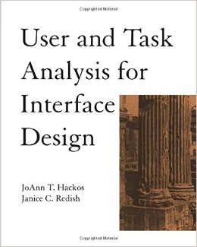
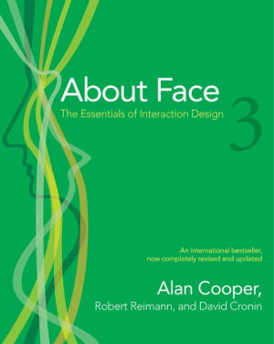
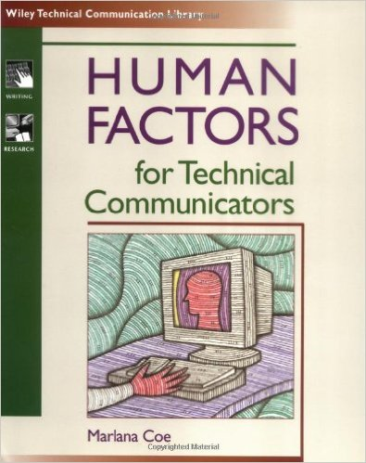
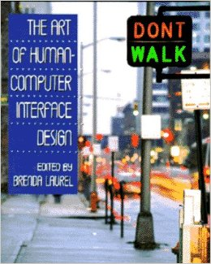
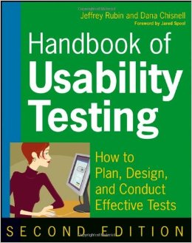
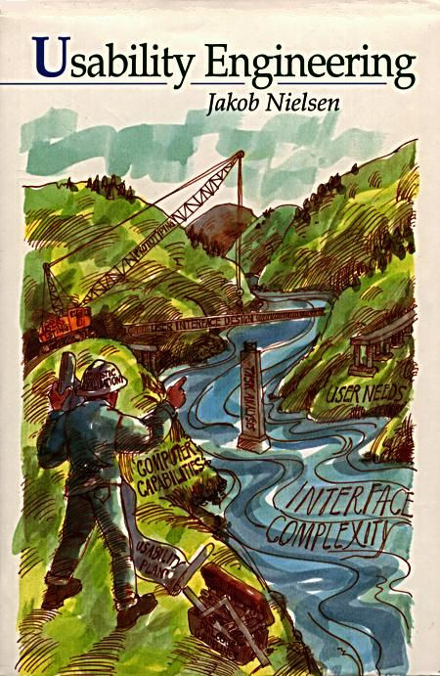
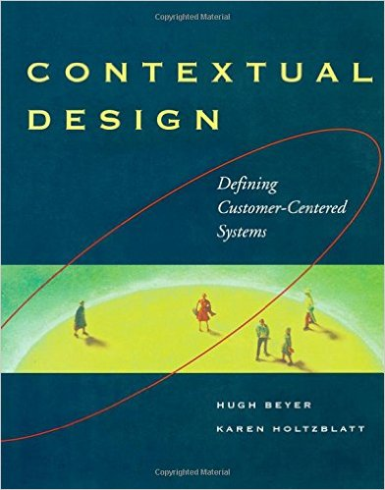
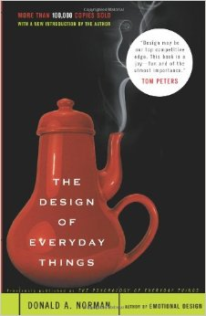
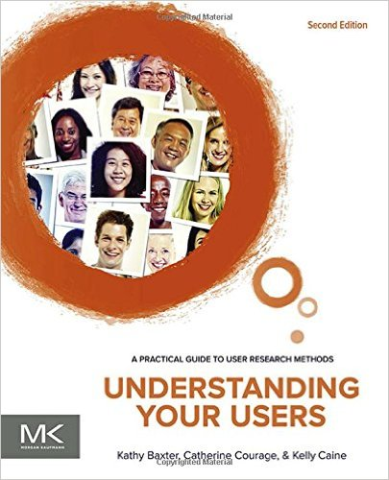
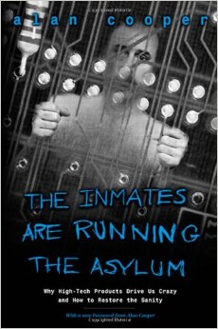
Rich History of Conversation
@CaitRyan // @LizaPotts
Notes:
And finally, it wasn’t because these concepts were brand new or situated in one field.
The roots of many of today’s conversations on applied participant-centered research date back to materials released during the late 1980s and 1990s with contributors from fields as diverse as technical communication, cognitive psychology, computer science, art and design, and theater.

Slide 7
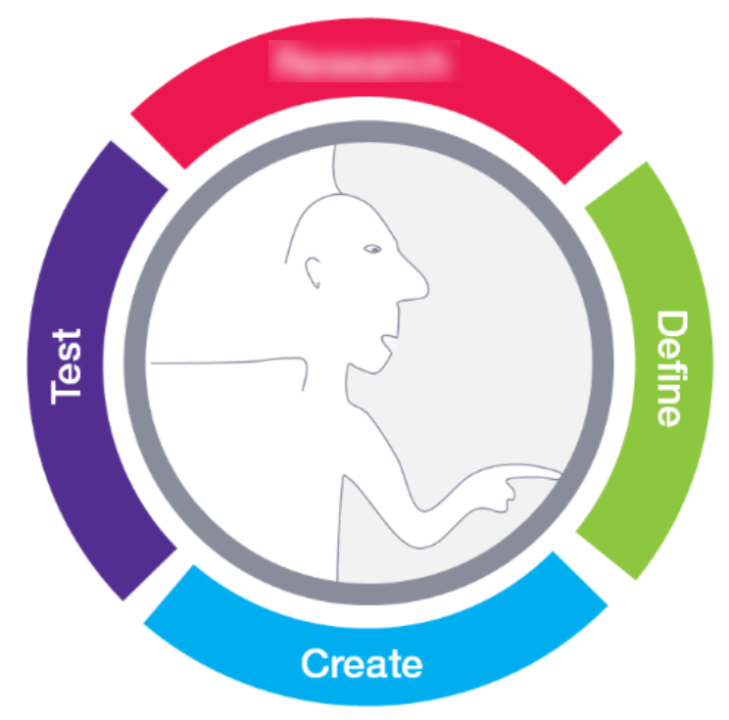
So Again, Why Hasn’t Research Arrived?
From Patrick D. Esser http://www.meetpatrick.de/
@CaitRyan // @LizaPotts
Notes:
But even with all of this investment and all of these resources both new and from past decades, we still see companies and practitioners struggling with participant-centered research. Along with resources teaching how to effectively conduct participant centered resources, there many resources teaching practitioners how to get their companies to incorporate it effectively.
Recently in 2012, Tomer Sharon published It’s Our Research, an entire book with the purpose of teaching practitioners how to get user research actually accepted, valued, and used at their companies. This work is still incredibly relevant and necessary for researchers who haven’t yet achieved this at their companies.
So we come back to the question of why.
Why are companies still trying to figure out how to make research an integral part of their process, and why are we as practitioners struggling to help?

Slide 8
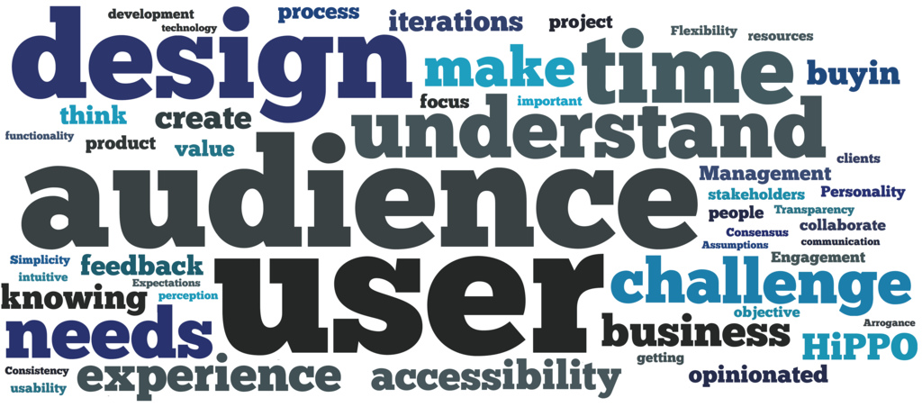
Fractured Terms and Methods
@CaitRyan // @LizaPotts
Notes:
Our experience, and our investigation of other’s experiences has shown us that a major reason for this discrepancy between the desire to make informed decisions based on research and actually putting that into practice is that different parts of organizations are often trying to pursue similar types of inquiry without collaborating with one another. In part, this is due to a fractured understanding of methods and terms for this same type of inquiry.
This issue was explored at SIGDOC in 2009 by Potts and Bartocci, and more recently in an article by Rosenfeld on A List Apart.
Just among user experience professionals it’s referred to as user research, usability, user experience research, design research, on a broader level and filled in with numerous micromethods.
This issue becomes even more pronounced as we move outside of user experience to look at other areas of industry including marketers, business strategists, and entrepeneurs, which we’ll explore in the next few slides.

Slide 9
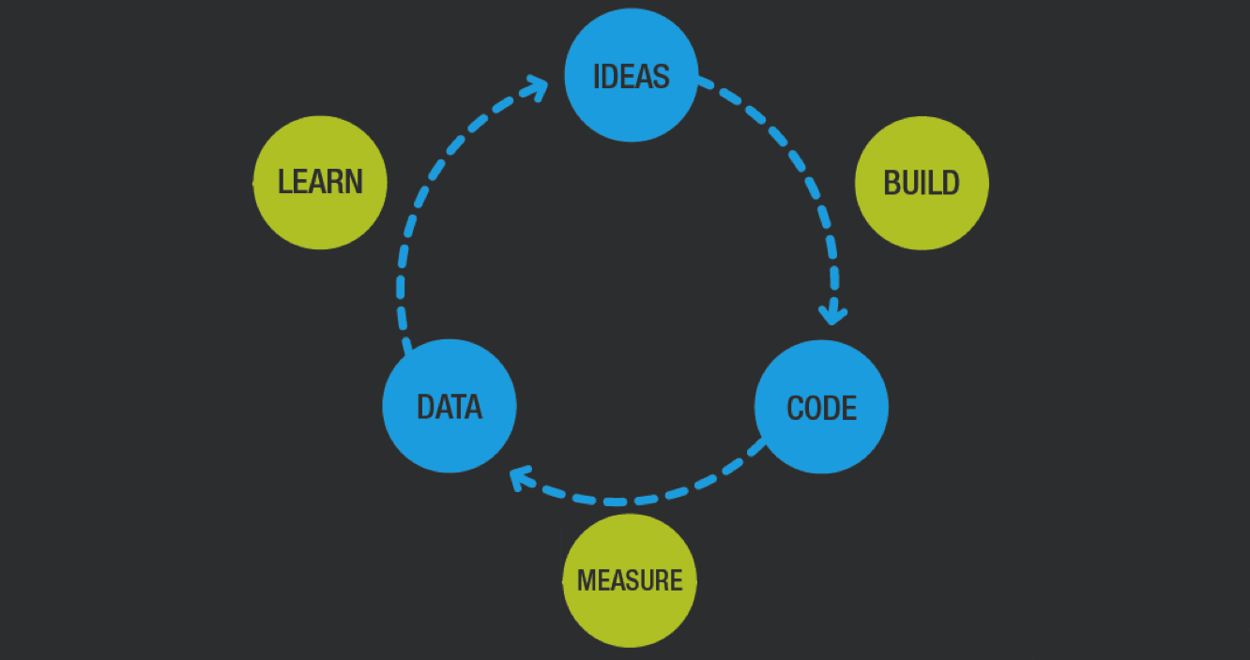
Picture representing validated learning
From Tomer Sharon’s It’s Our Research 2012
Eric Ries from www.leanstartup.com
The Lean Startup
@CaitRyan // @LizaPotts
Notes:
The first industry methodology we’ll look at is the Lean Startup movement, which has gained a lot of traction in software in particular.
This movement was founded by Eric Ries and became popular when he published The Lean Startup book in 2011.
Within Lean there’s a core concept called validated learning.
Which, according to Ries, is “the process of demonstrating empirically that a team has discovered valuable truths about a startup’s present and future business prospects.”
Which, if you read the examples in the book, often translates into interviewing and observing customers to learn, as Ries puts it “what they really want” as opposed to “what they say they want or what we think they should want” [28].

Slide 10
Insert a picture of someone using a remote control
From Tomer Sharon’s It’s Our Research 2012
NIHITO®
@CaitRyan // @LizaPotts
Notes:
The next industry method for participant centered research we looked at is the NIHITO® visit which comes from the Pragmatic Marketing framework.
These NIHITO visits, which translates to “Northing Important Happens in the Office” are intended to be in-person visits with customers and potential customers which enable product teams to uncover and validate market problems.
One example they use is that of a television manufacturer trying to improve their offerings.
While visiting numerous customers in their homes, they were able to see that these customers were constantly losing their remote controls.
By identifying this as a key problem, they were then able to identify ways to help customers keep track of their remotes.

Slide 11
Insert a picture of people ordering/drinking milkshakes
From Tomer Sharon’s It’s Our Research 2012
“Ordering Krystals” by Flickr User Judy Baxter
Jobs to be Done
@CaitRyan // @LizaPotts
Notes:
The other industry example we’ll talk about is the Jobs to Be Done interview, which comes originally from Anthony Ulwick’s concept of outcome-driven innovation in What Customers Want [35].
The most well known example of this type of interview is the example of milkshakes at a popular fast food chain provided by Clayton Christensen in The Innovators Solution [4].
The chain was trying to improve their milkshakes to increase sales.
Researchers began by observing customers throughout the course of the day to find patterns in milkshake purchases.
One of these observed patterns was that commuters frequently purchased shakes in the morning on their way to work.
These observations shifted into interviews with the goal of learning why these purchases were being made.
The researchers discovered that milkshakes were being purchased because the commuters needed something to eat before work so they wouldn’t crash by lunchtime.
Their reasoning for choosing the milkshake was that the milkshake would take some time to eat, make the commute less boring, and be mess-free because it could be consumed from a cup with one hand.

Slide 12
Validated Learning, Jobs to be Done, etc.
Contextual Inquiry
Does this sound familiar?
@CaitRyan // @LizaPotts
Notes:
There are a number of other methods that, like the two we’ve mentioned here rely primarily on observed behavior and inquiry to understand human behavior.
In other words, these methods constitute what UX practitioners would consider contextual inquiry.
However, there is a sense that the practitioners of these activities consider them to be unique and separate from the concepts of participant-centered research.

Slide 13
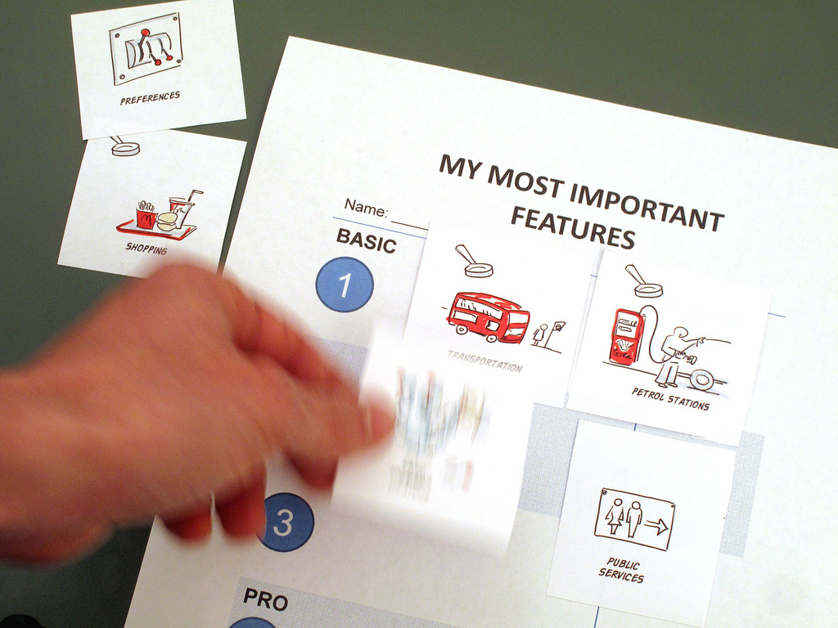
From Tomer Sharon’s It’s Our Research 2012
From Tomer Sharon’s It’s Our Research 2012
Industry Methods vs. Research
@CaitRyan // @LizaPotts
Notes:
The desire to integrate participant-based research as a core business practice is a positive step in the right direction.
However, these different approaches are creating a battle for terms, methods and space that is limiting progress in implementation.
There is an impression within some of these industry methods that “research” is done at the expense of business goals rather than aiding in achieving business goals while these new industry methods are helping with business goals..
For example, in Lean Customer Development, Cindy Alvarez separates what she is describing from user research by claiming that user research is “advocating for the user,” while customer development is “advocating for the business” [2]. These issues of wanting to separate research practices from the term research are surfacing in ways that should be addressed by industry practitioners and academic researchers alike.
As industry is becoming more interested in applying the concepts of participant-based research, this fragmentation of terms and methodology slows adoption and has created a situation in which many companies, though interested, do not have a clear grasp of how to make participant-centered research an integral part of their process, and the fact that user experience professionals have the skills needed to guide these conversations.
In addition, the adoption of these new industry methodologies combined with an aversion toward “user research” increases the potential for pushing user experience professionals away from these conversations rather than toward them.

Slide 14
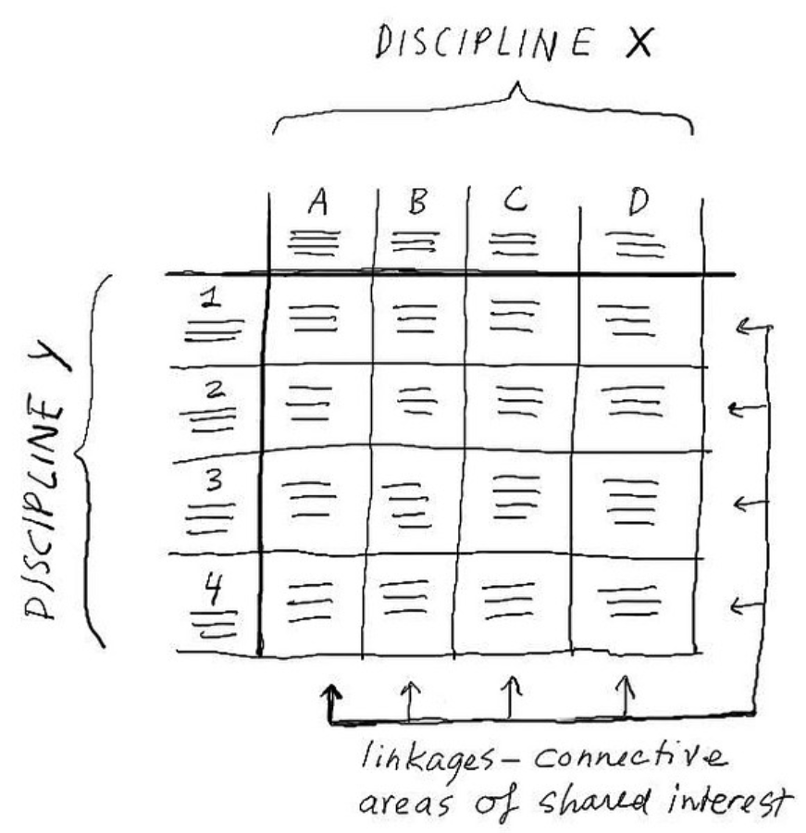
From Lou Rosenfeld “Seeing the Elephant: Defragmenting User Research”
Connecting Terms/Empowering Collaborators
@CaitRyan // @LizaPotts
Notes:
There are many potential solutions, but the one we are proposing today posits that we simply stop arguing over the naming of these methods.
Despite the differences in terms and methods, there is growing agreement that the core concepts behind participant-focused research are important for creating useful products and services. We can do this by avoiding arguing over terms, and instead, working together to create better user experiences.
When we lock ourselves in by arguing over the name of a particular method, we lose sight of the actual goal of engaging in that method. We also cut off conversations that might allow research insights from multiple areas of the organization to be shared and build on one other.
Instead, we are suggesting that we focus on effectively communicating our existing knowledge and expertise while working with teams across the company.
We need to be able to seek out potential researchers from any area of the organization and learn to show connections between their goals and ours. This also doesn’t have to be a hugely complicated process, as demonstrated by this diagram from Lou Rosenfeld in his article on defragmenting the user experience.
These collaborative activities move our roles from being purely tactical to being more strategic in nature, allowing us to focus on connecting sources of information and empowering organizations to take full advantage of the information gained by engaging with customers.
If we think of our work as strategic in this way, we can lead these projects and our companies in ways where our participants benefit from all of our shared research and knowledge.

Slide 15
Website: http://xa.cal.msu.edu/
Futures for Researchers as Strategists
@CaitRyan // @LizaPotts
Notes:
The fact that there are so many people across industry who are understanding the value of participant-centered research and attempting to implement it in their organizations (whether or not they think of it as participant centered-research) is a wonderful thing.
In order to lead this movement towards integrating participant-centered research across the organization, we need to move into strategic roles, rather than engaging as pure researcher.
We are already seeing this happen for content strategists.
These practitioners have the greatest success when they shift from managing and writing content to working across the organization to link business goals and content practices.
We need to do similar work for participant-based research, and taking on the role of the user experience architect: a strategist who can create a shared language for various participants and stretch across the organization as a problem-solver.
In the same way that content writers and managers have shifted towards content strategy roles becoming more strategic in our approach to research will help us bring our organizations together in order to create more useful, innovative, and successful products.
Instead of being the sole practitioners conducting research, we must work to understand the terms and methods used by all potential researchers throughout our organizations, find the similarities, and strategically connect research practices under their many names throughout our organizations.
Programs like MSU’s undergraduate program in experience architecture are one step toward training new practitioners with this way of thinking.
At the same time, those who are already practitioners can make strides to taking on this strategic role.
In addition, understanding how to make these connections is also a place where we need more research from academia.
As programs in technical communication expand and grow, we can see a place for experience architecture research to flourish. By leading industry in connecting and defining shared terms, we can have an impact on how the role of participant-centered research evolves in industry. In doing so, we can help user experience architects move into strategic roles that work across these organizations in order to create more human-centered and therefore more useful, innovative, and successful products and services.

